Slide 1
Discovery of Latent 3D Keypoints via End-to-end Geometric Reasoning
Marat Saidov, AMI171
September, 22th

Slide 2
01. SHAPENET
04. APPLICATIONS IN CV
02. ARCHITECTURE & LOSSES
05. VISUALIZATION
03. REGULARIZATION
Dataset’s components
And a crucial property
Pose2Seg: human instance segmentation
Visually interpretable objective functions
Ablation studies and exceptional cases
Keypoints modeling is unstable

Slide 3
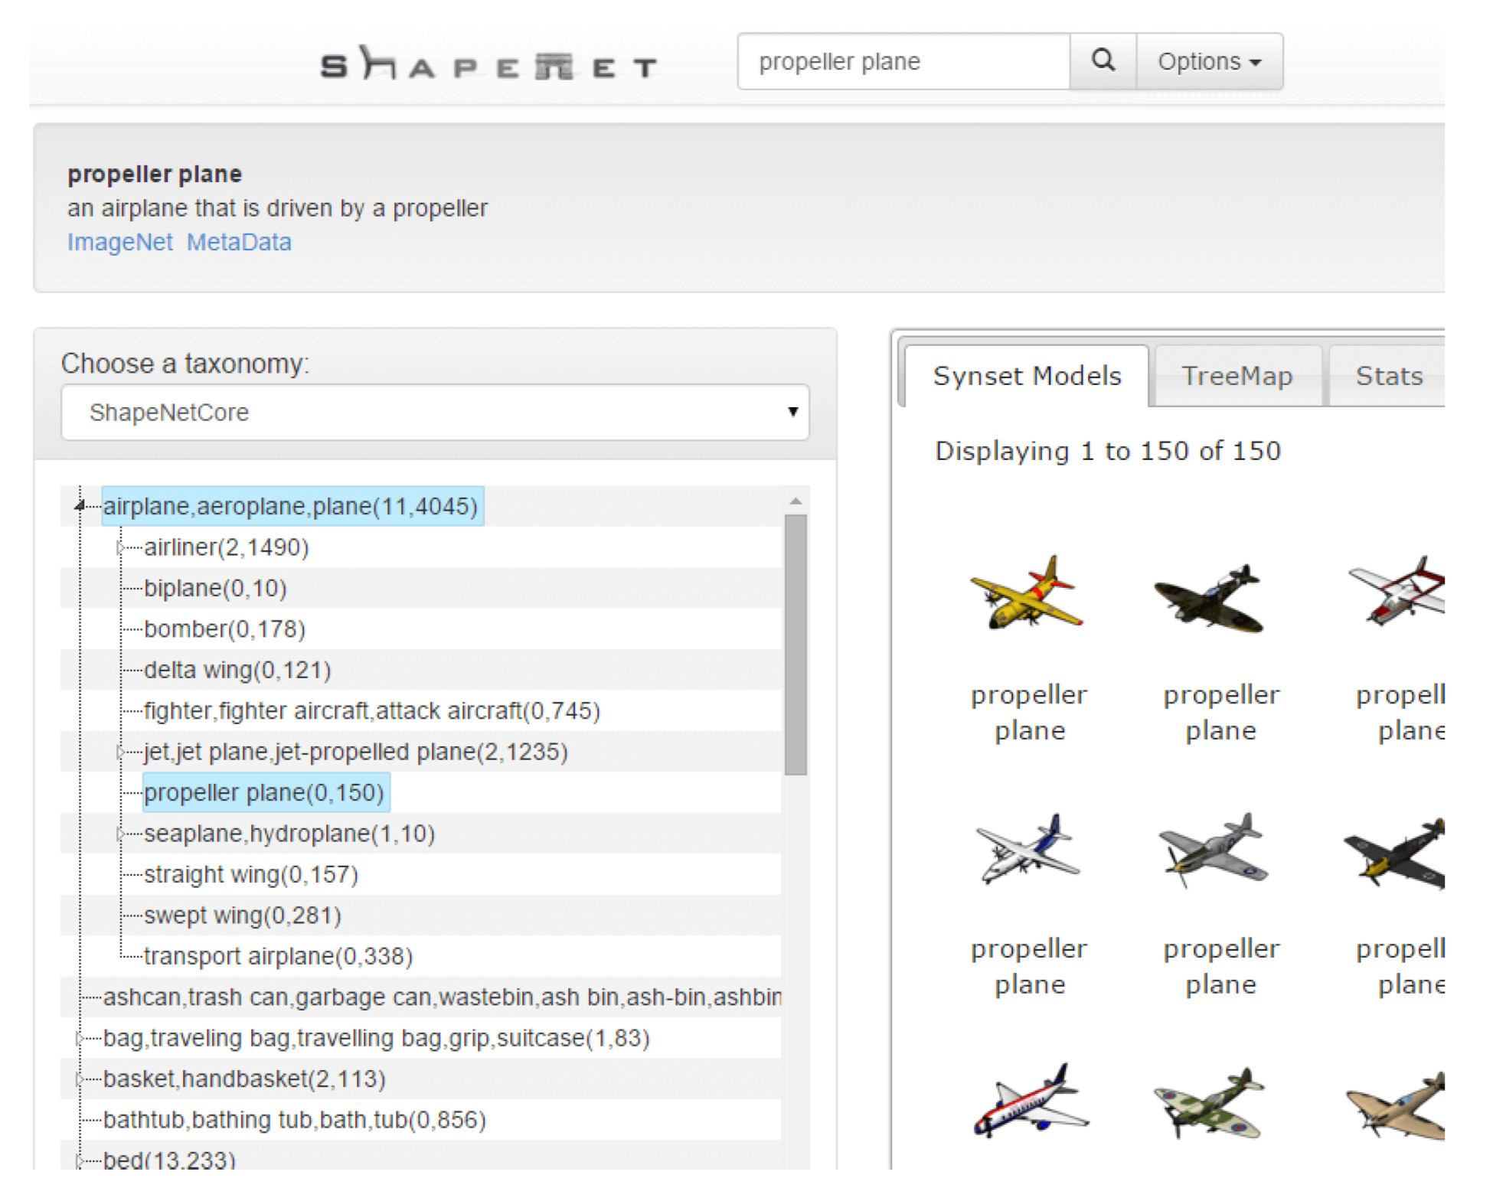
ShapeNet
WELL-STRUCTURED 3D-MODELS DATASET
Salient physical attributes: planes of symmetry, parts decompositions;
Interfaces: textual keywords, taxonomy traversal, image & shape similarity search;
1

Slide 4
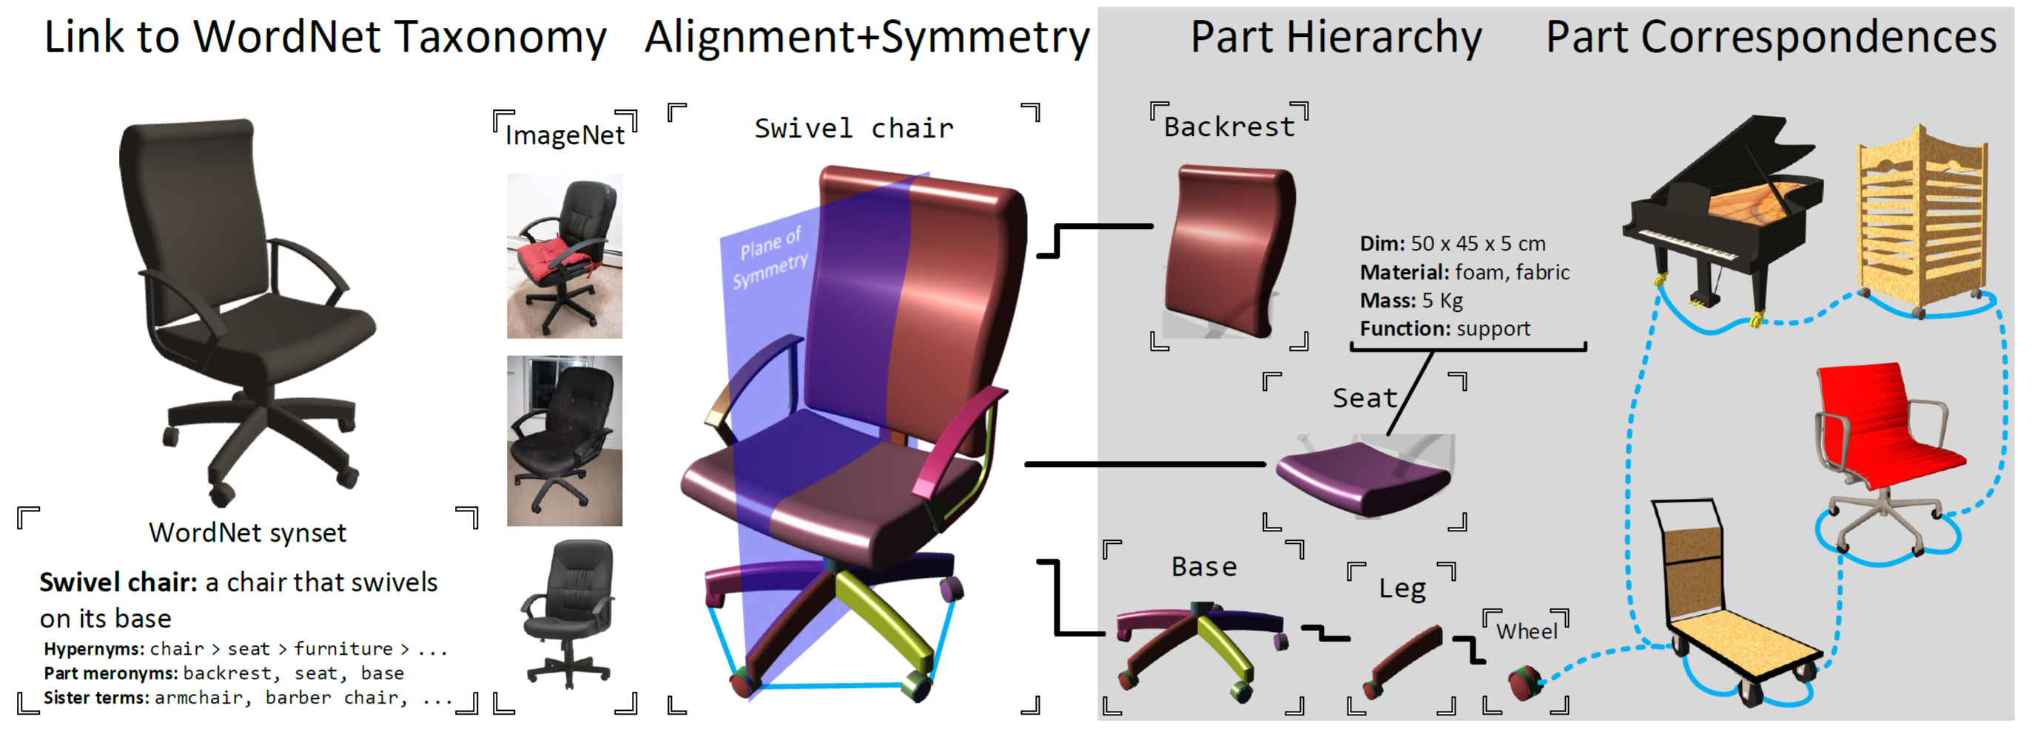
ShapeNet
PARTS DECOMPOSITIONS
2

Slide 5
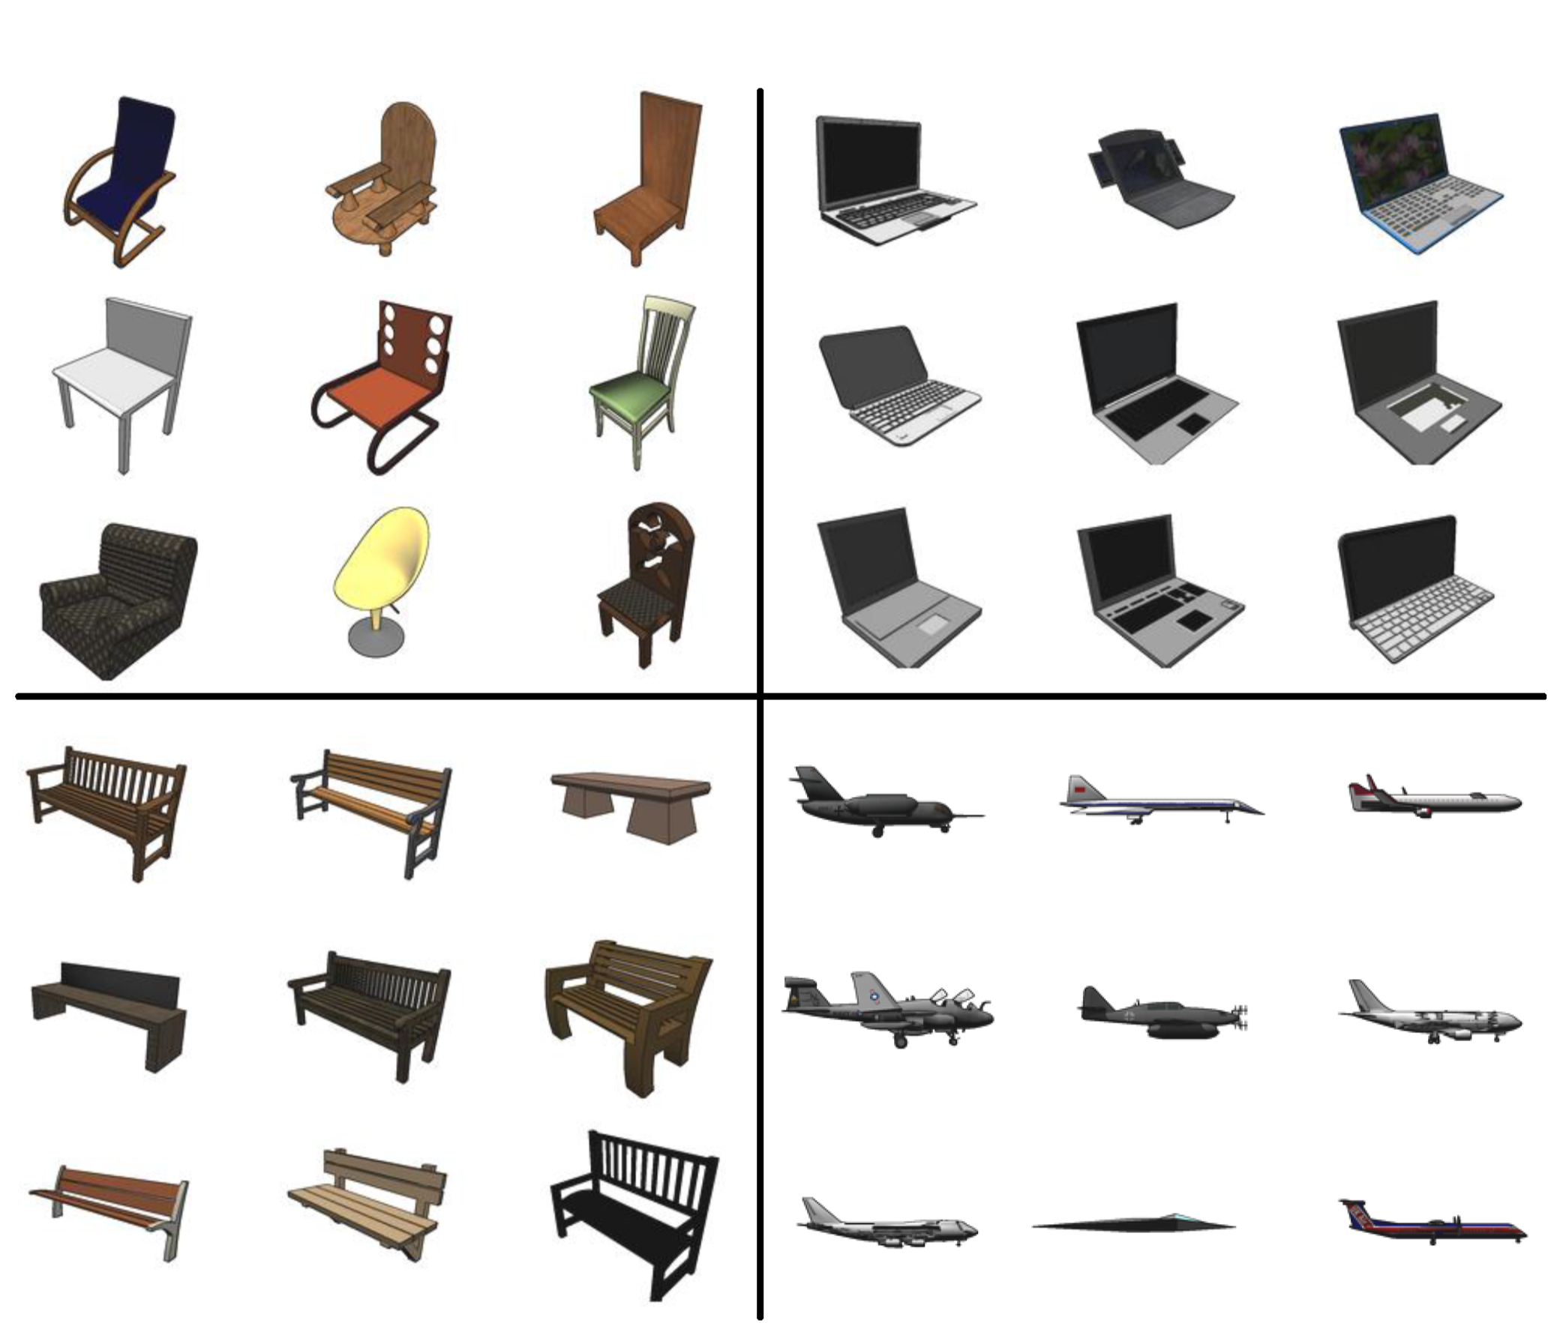
ShapeNet
RIGID ALIGNMENTS
An algorithm of rigid alignments
Bottom-up manner: gradually elevating from low-level categories;
Low-level shape is a random variable;
Tree-structured set of variables is a
Markov Random Field (MRF);
Discretized set of rigid transformations;
MRF measures a consistency over all
transformations;
Insignificant human supervision;
3

Slide 6
KeypointNet
GENERAL VIEW
Learns set of category-specific 3D keypoints which could be optimized for
a downstream task. It does not obtain ground-truth keypoint annotations.
4

Slide 7
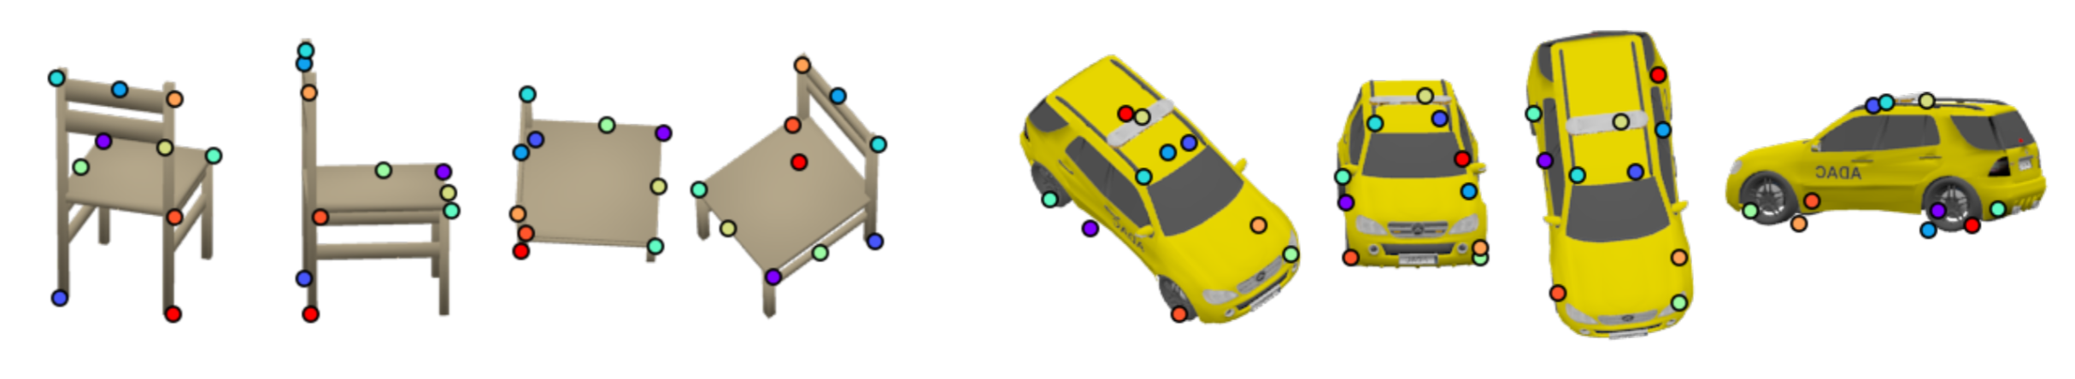
KeypointNet
GENERAL VIEW
3D Keypoint = Pixel Coordinate + Associated Depth
Modeling an ordered list of 3D keypoints for a single image:
Occluded points;
Generalization over different views;
5

Slide 8
KeypointNet
GENERAL VIEW
Informative properties of keypoints:
Distinctiveness / diversity;
Ease of detection;
Restriction on a downstream task: an objective function should be differentiable w.r.t keypoints values;
6

Slide 9
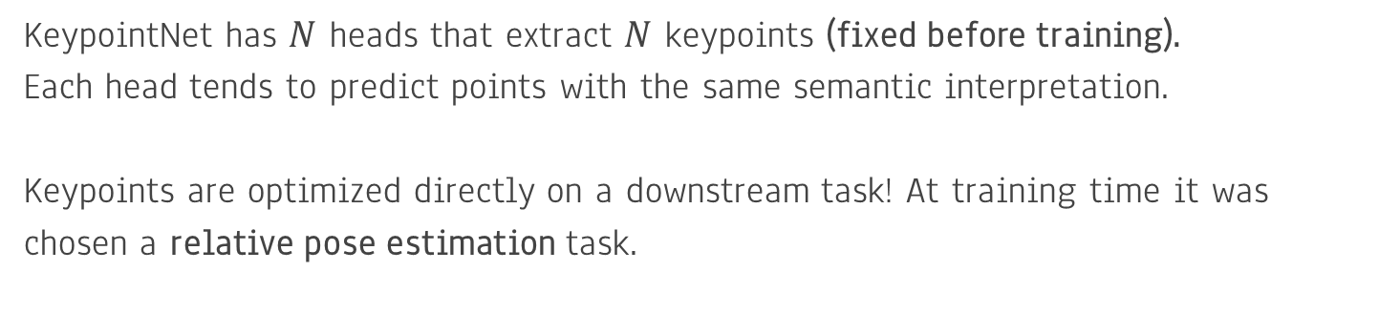
KeypointNet
OBJECTIVE FUNCTION
KeypointNet has $N$ heads that extract $N$ keypoints (fixed before training).
Each head tends to predict points with the same semantic interpretation.
Keypoints are optimized directly on a downstream task! At training time it was chosen a relative pose estimation task.
7

Slide 10
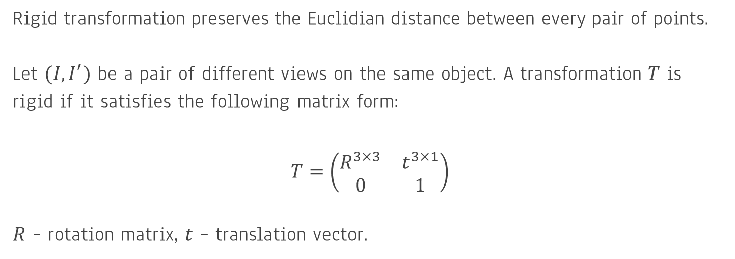
KeypointNet
RIGID TRANSFORMATIONS
Rigid transformation preserves the Euclidian distance between every pair of points.
Let $(I,I^{′})$ be a pair of different views on the same object. A transformation $T$ is rigid if it satisfies the following matrix form:
$$T=\left(\begin{matrix}R^{3×3} & t^{3×1} \\ 0 & 1\end{matrix}\right)$$
$R$ – rotation matrix, $t$ – translation vector.
8

Slide 11
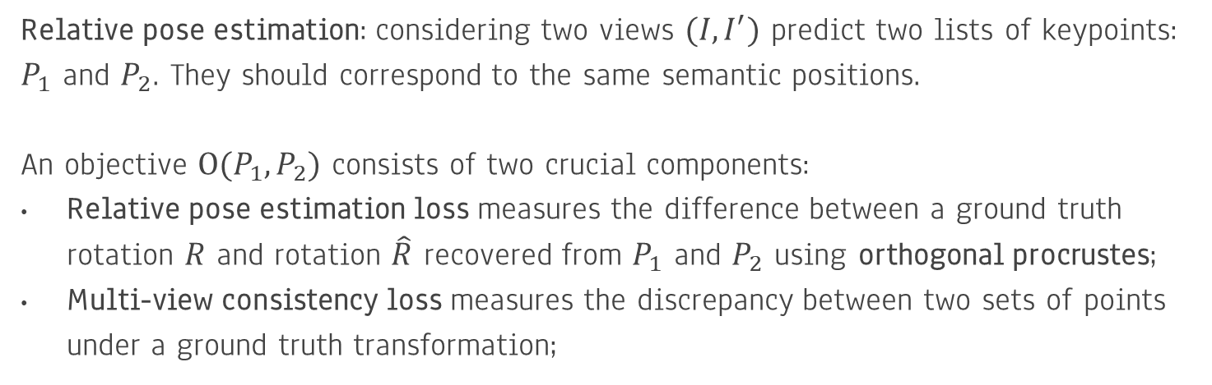
KeypointNet
OBJECTIVE FUNCTION
Relative pose estimation: considering two views $(I,I^{′})$ predict two lists of keypoints: $P_{1}$ and $P_{2}$. They should correspond to the same semantic positions.
An objective $O(P_{1},P_{2})$ consists of two crucial components:
Relative pose estimation loss measures the difference between a ground truth rotation $R$ and rotation $\hat{R}$ recovered from $P_{1}$ and $P_{2}$ using orthogonal procrustes;
Multi-view consistency loss measures the discrepancy between two sets of points under a ground truth transformation;
9

Slide 12
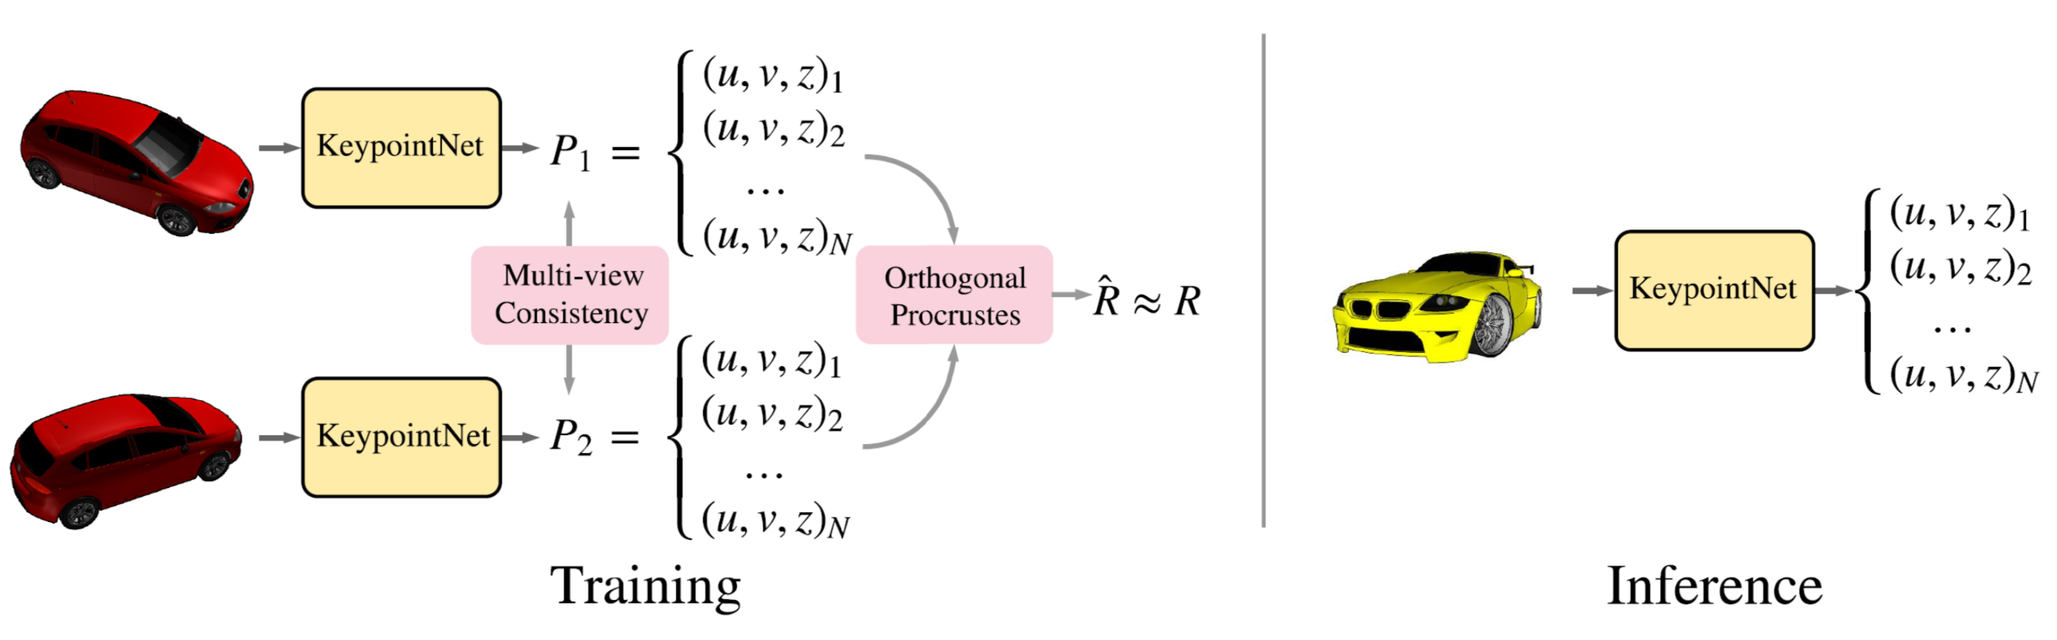
KeypointNet
ARCHITECTURE
These two terms allow to predict meaningful locations. However, they could be suboptimal.
10

Slide 13
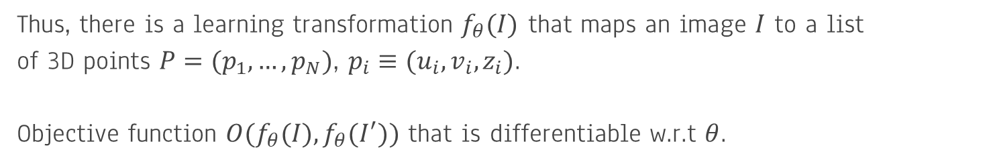
KeypointNet
ARCHITECTURE
Thus, there is a learning transformation $f_{θ}(I)$ that maps an image $I$ to a list
of 3D points $P=(p_{1},…,p_{N})$, $p_{i}≡(u_{i},v_{i},z_{i})$.
Objective function $O(f_{θ}(I),f_{θ}(I^{′}))$ that is differentiable w.r.t $θ$.
11

Slide 14
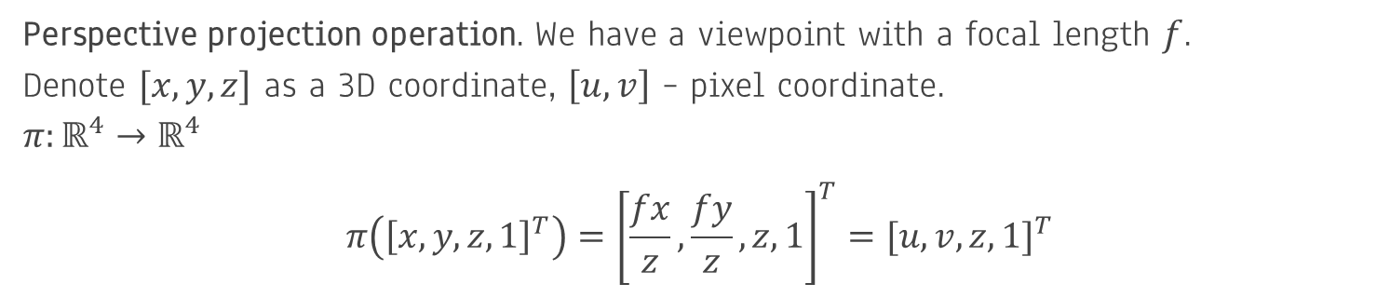
KeypointNet
MULTI-VIEW CONSISTENCY
Perspective projection operation. We have a viewpoint with a focal length $f$.
Denote $[x,y,z]$ as a 3D coordinate, $\left[u,v\right]$ – pixel coordinate.
$$π:ℝ^{4}→ℝ^{4}$$
$$π\left({\left[x,y,z,1\right]}^{T}\right)={\left[\frac{fx}{z},\frac{fy}{z},z,1\right]}^{T}={[u,v,z,1]}^{T}$$
12

Slide 15
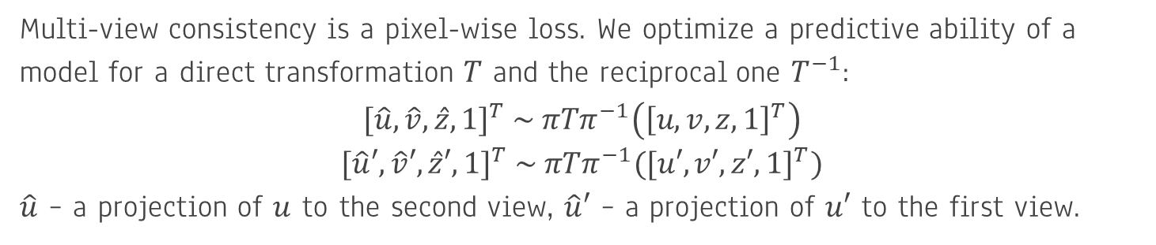
KeypointNet
MULTI-VIEW CONSISTENCY
Multi-view consistency is a pixel-wise loss. We optimize a predictive ability of a model for a direct transformation $T$ and the reciprocal one $T^{−1}$:
$${[\hat{u},\hat{v},\hat{z},1]}^{T} \sim πTπ^{−1}\left({\left[u,v,z,1\right]}^{T}\right)$$
$${[\hat{u}′,\hat{v}′,\hat{z}′,1]}^{T} \sim πTπ^{−1}({[u′,v′,z′,1]}^{T})$$
$\hat{u}$ – a projection of $u$ to the second view, $\hat{u}′$ – a projection of $u′$ to the first view.
13

Slide 16
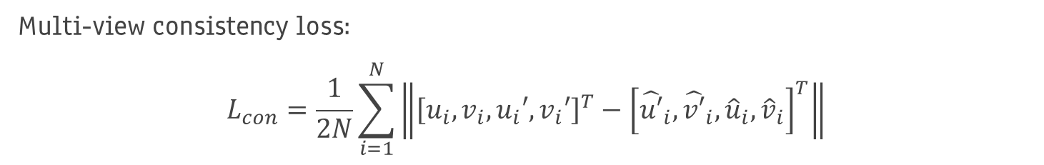
KeypointNet
MULTI-VIEW CONSISTENCY
Multi-view consistency loss:
$$L_{con}=\frac{1}{2N}\sum_{i=1}^{N}{\left\|{\left[u_{i},v_{i},u_{i}′,v_{i}′\right]}^{T}−{\left[{\hat{u′}}_{i},{\hat{v′}}_{i},{\hat{u}}_{i},{\hat{v}}_{i}\right]}^{T}\right\|}$$
Depth is measured with different units and never directly observed.
However, its knowledge is crucial to project between 3D and pixel views.
14

Slide 17
KeypointNet
MULTI-VIEW CONSISTENCY
An optimal set of keypoints with multi-view consistency leads to a collapse into one single location.
Natural way of encouragement their diversity is the usage of a downstream task.
15

Slide 18
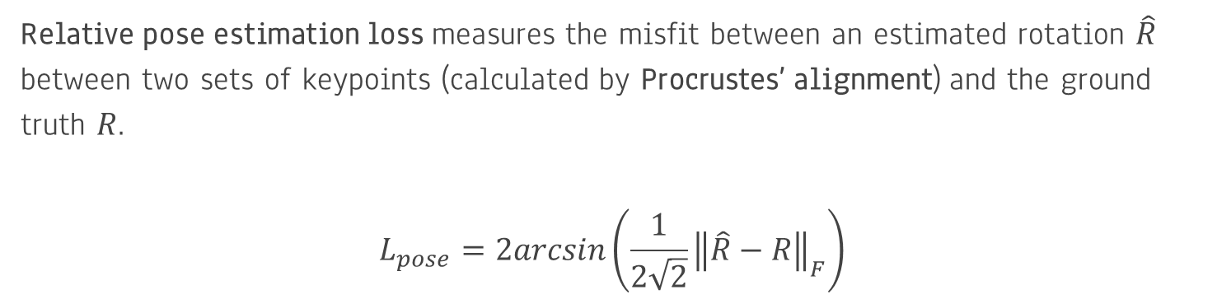
KeypointNet
RELATIVE POSE ESTIMATION
Relative pose estimation loss measures the misfit between an estimated rotation $\hat{R}$
between two sets of keypoints (calculated by Procrustes’ alignment) and the ground truth $R$.
$$L_{pose}=2arcsin\left(\frac{1}{2\sqrt{2}}{\left\|\hat{R}−R\right\|}_{F}\right)$$
16

Slide 19
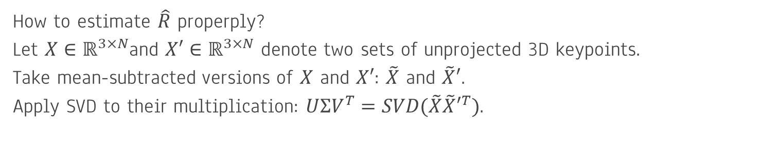
KeypointNet
ORTHOGONAL PROCRUSTES PROBLEM
How to estimate $\hat{R}$ properply?
Let $X∈ℝ^{3×N}$and $X′∈ℝ^{3×N}$ denote two sets of unprojected 3D keypoints.
Take mean-subtracted versions of $X$ and $X′$: $\tilde{X}$ and $\tilde{X}′$.
Apply SVD to their multiplication: $UΣV^{T}=SVD(\tilde{X}{\tilde{X}′}^{T})$.
17

Slide 20
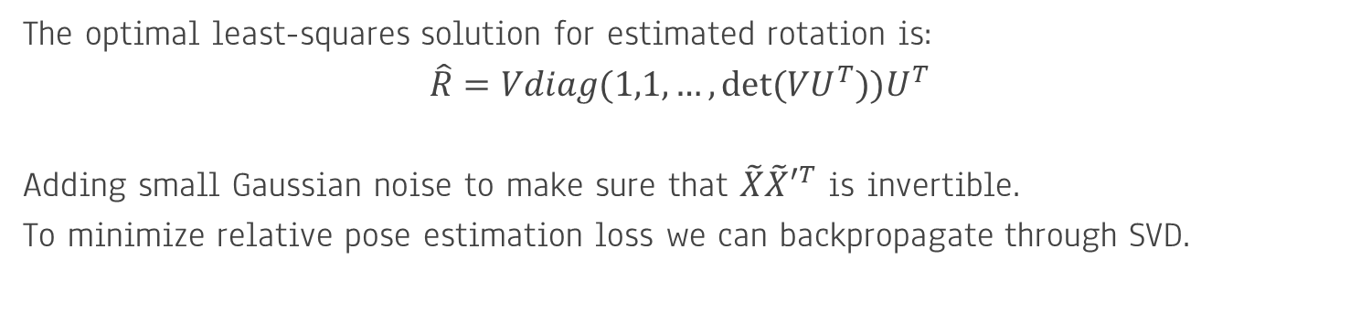
KeypointNet
ORTHOGONAL PROCRUSTES PROBLEM
The optimal least-squares solution for estimated rotation is:
$$\hat{R}=Vdiag(1,1,…,det⁡(VU^{T}))U^{T}$$
Adding small Gaussian noise to make sure that $\tilde{X}{\tilde{X}′}^{T}$ is invertible.
To minimize relative pose estimation loss we can backpropagate through SVD.
18

Slide 21
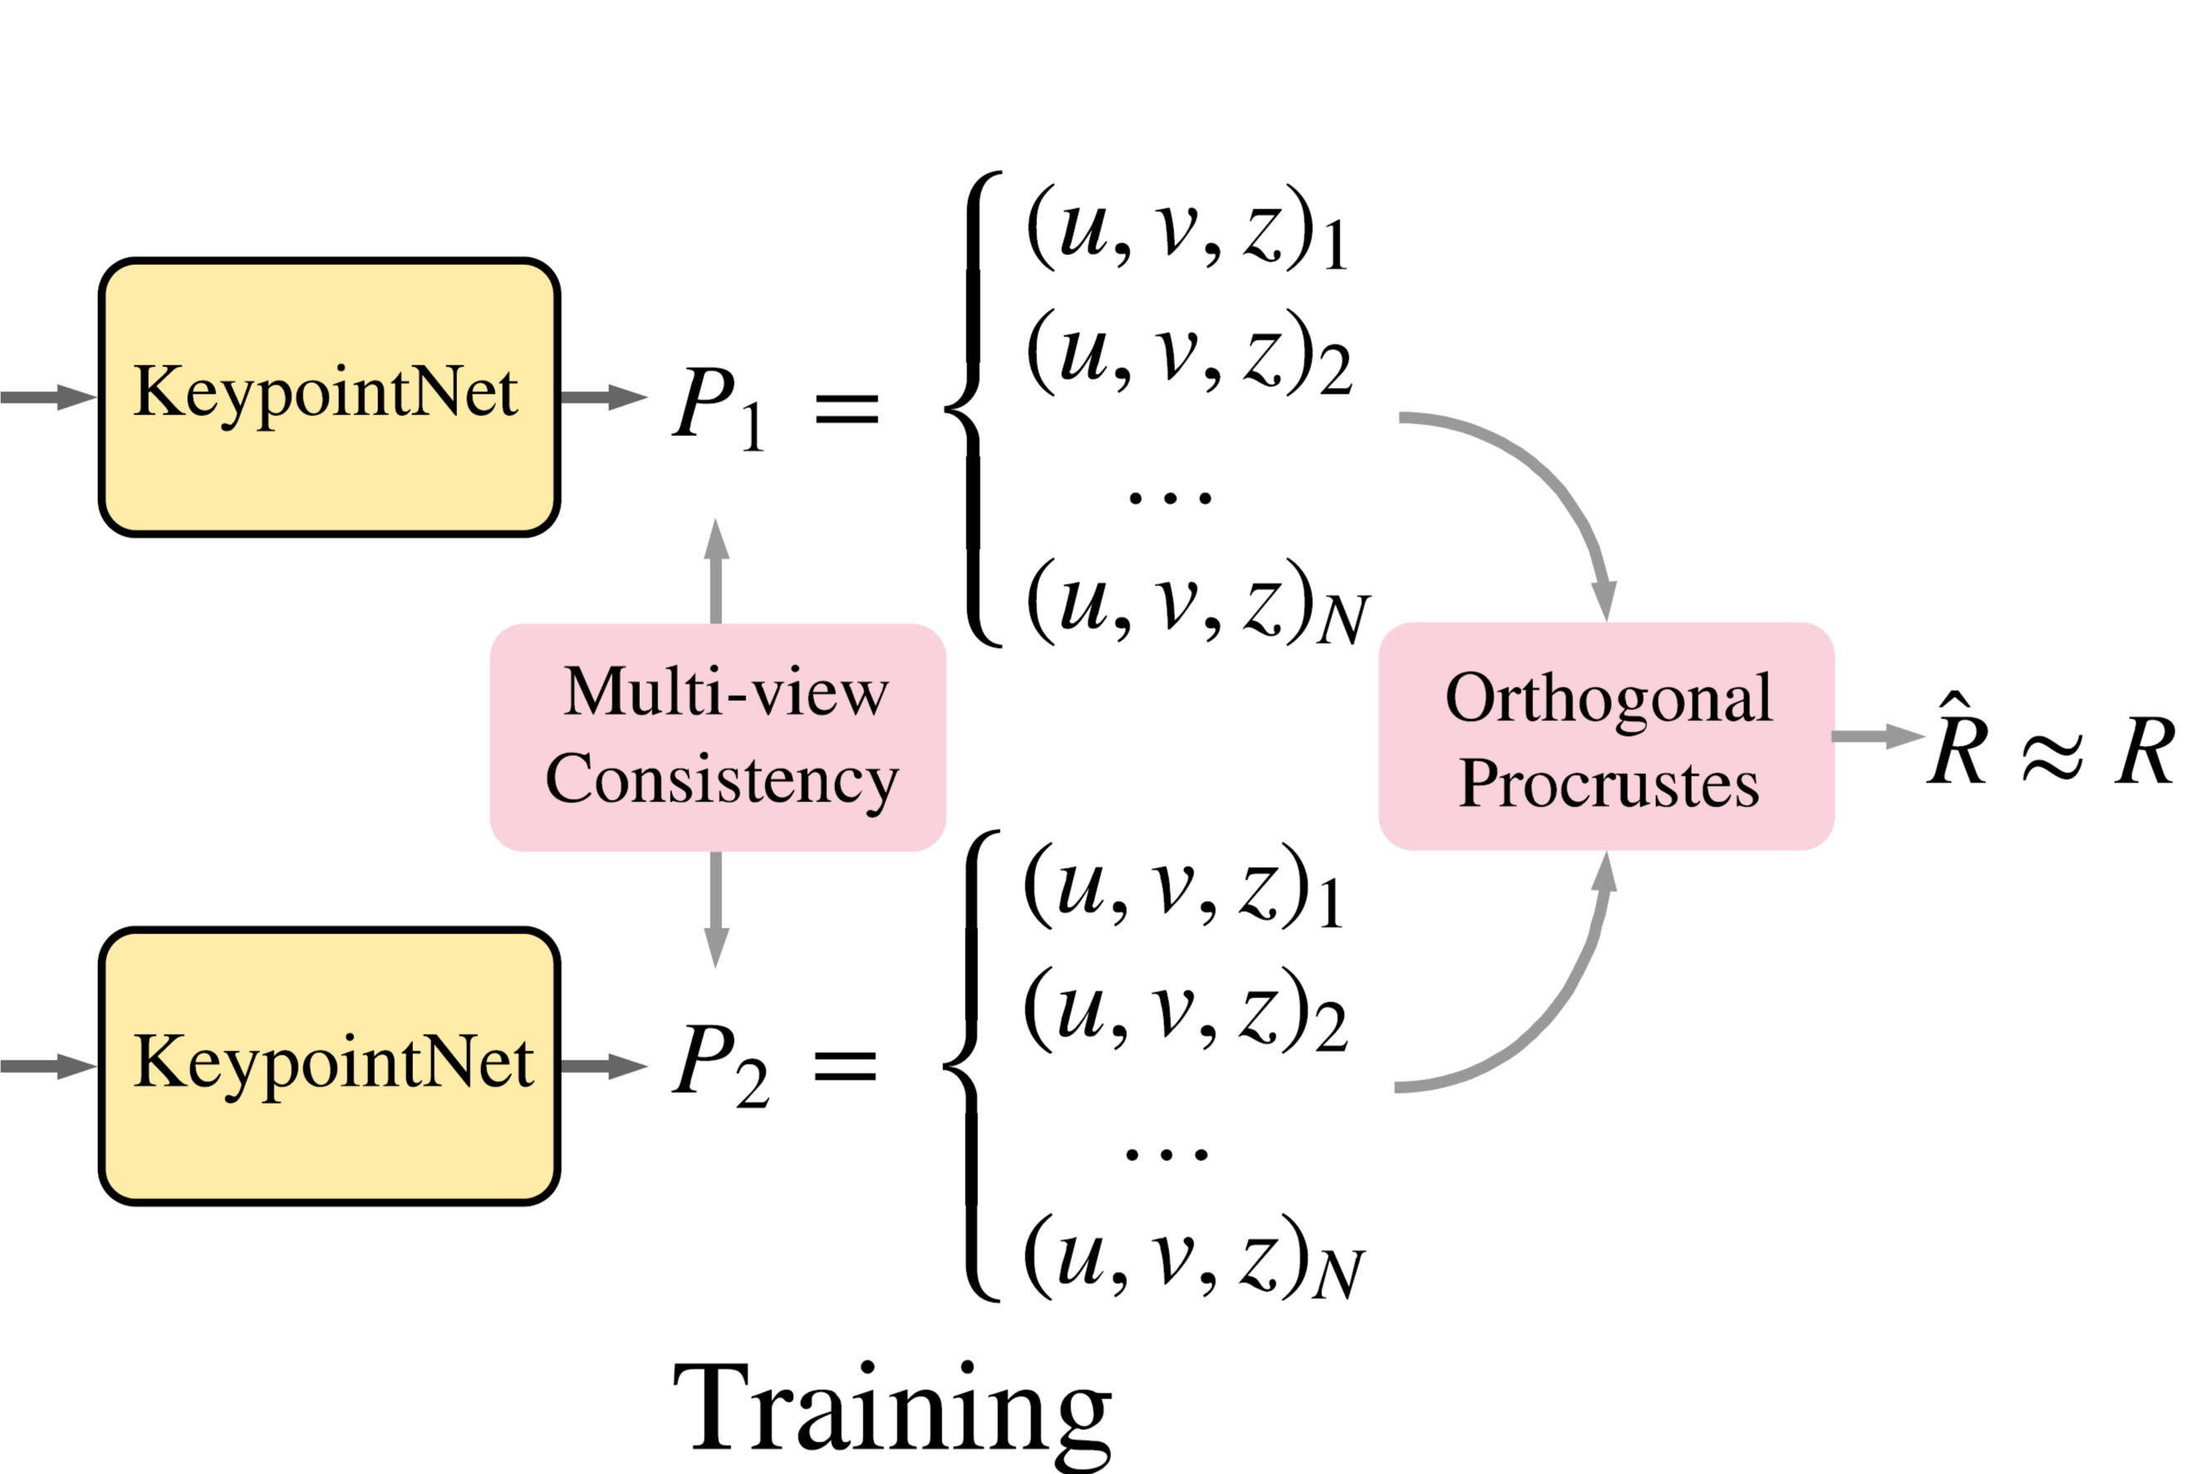
KeypointNet
ORTHOGONAL PROCRUSTES PROBLEM
19

Slide 22
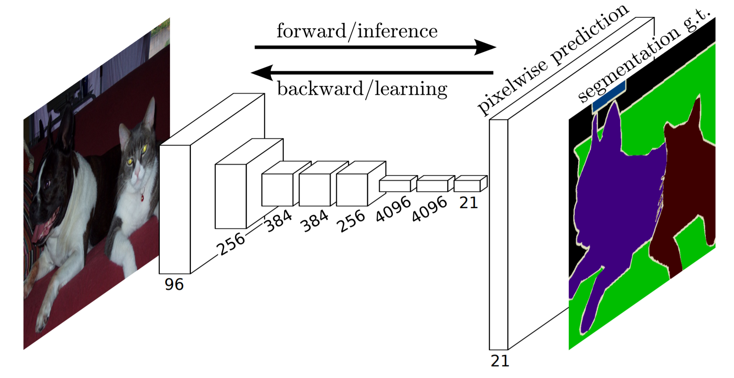
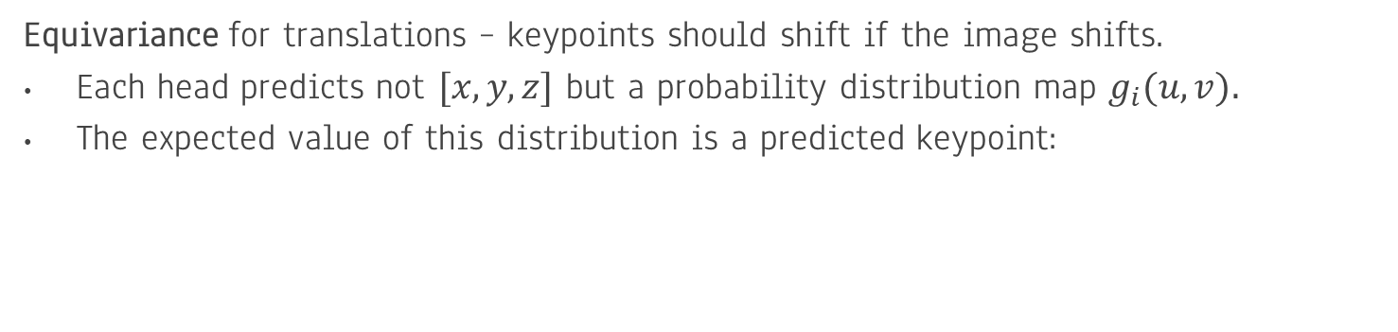

KeypointNet
ARCHITECTURE
Equivariance for translations – keypoints should shift if the image shifts.
Each head predicts not $[x,y,z]$ but a probability distribution map $g_{i}(u,v)$.
The expected value of this distribution is a predicted keypoint:
$${[u_{i},v_{i}]}^{T}=\sum_{u,v}{{[u∙g_{i}\left(u,v\right),v∙g_{i}(u,v)]}^{T}}$$
20

Slide 23
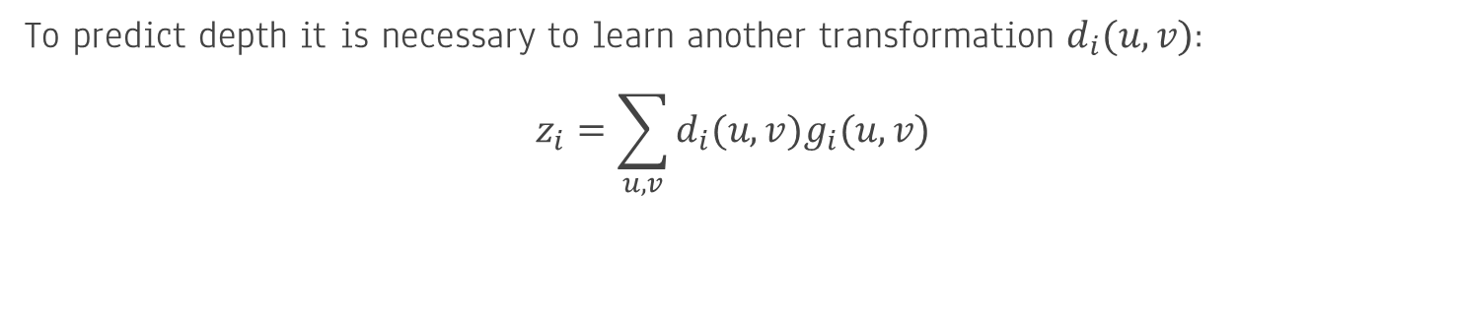
KeypointNet
ARCHITECTURE
To predict depth it is necessary to learn another transformation $d_{i}(u,v)$:
$$z_{i}=\sum_{u,v}{d_{i}(u,v)g_{i}(u,v)}$$
21

Slide 24
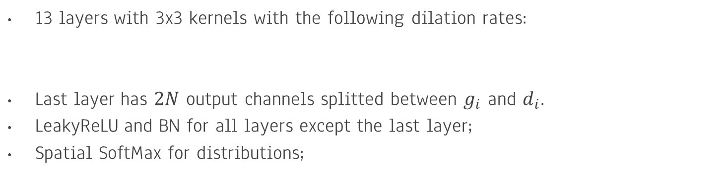
KeypointNet
ARCHITECTURE
1 | 1 | 2 | 4 | 8 | 16 | 1 | 2 | 4 | 8 | 16 | 1 | 1
13 layers with 3x3 kernels with the following dilation rates:
Last layer has $2N$ output channels splitted between $g_{i}$ and $d_{i}$.
LeakyReLU and BN for all layers except the last layer;
Spatial SoftMax for distributions;
22

Slide 25
KeypointNet
SYMMETRICAL OBJECTS
Symmetrical parts of an object should not be perceived identically.
Understanding global context: e.g., knowing car orientation helps to differ left wheels from the right wheels.
Using consistent orientations from ShapeNet.
23

Slide 26
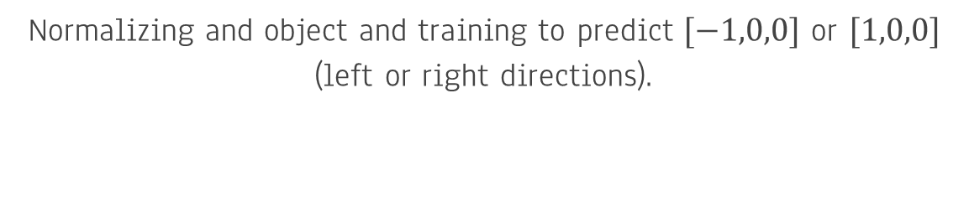
KeypointNet
SYMMETRICAL OBJECTS
Additional half-sized network to predict a binary flag: supervised from ShapeNet.
Normalizing and object and training to predict $[−1,0,0]$ or $[1,0,0]$ (left or right directions).
Use such predictions to aid KeypointNet main model.
24

Slide 27
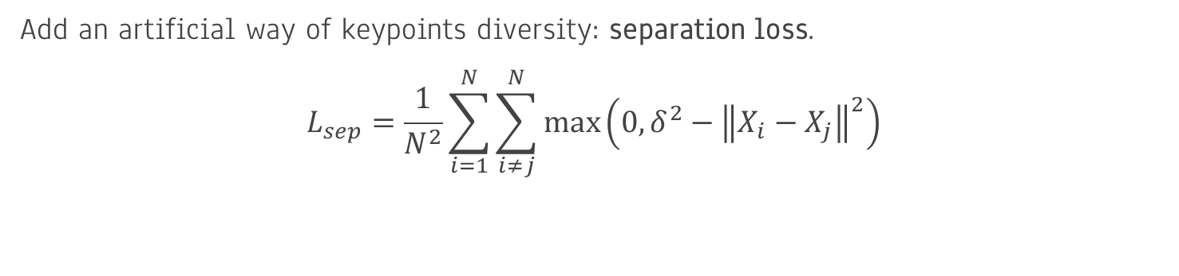
KeypointNet
REGULARIZATION
Add an artificial way of keypoints diversity: separation loss.
$$L_{sep}=\frac{1}{N^{2}}\sum_{i=1}^{N}{\sum_{i≠j}^{N}{max⁡\left(0,δ^{2}−{\left\|X_{i}−X_{j}\right\|}^{2}\right)}}$$
Loss is computed between 3D points to let keypoints have the same pixel
location with a different depth.
25

Slide 28
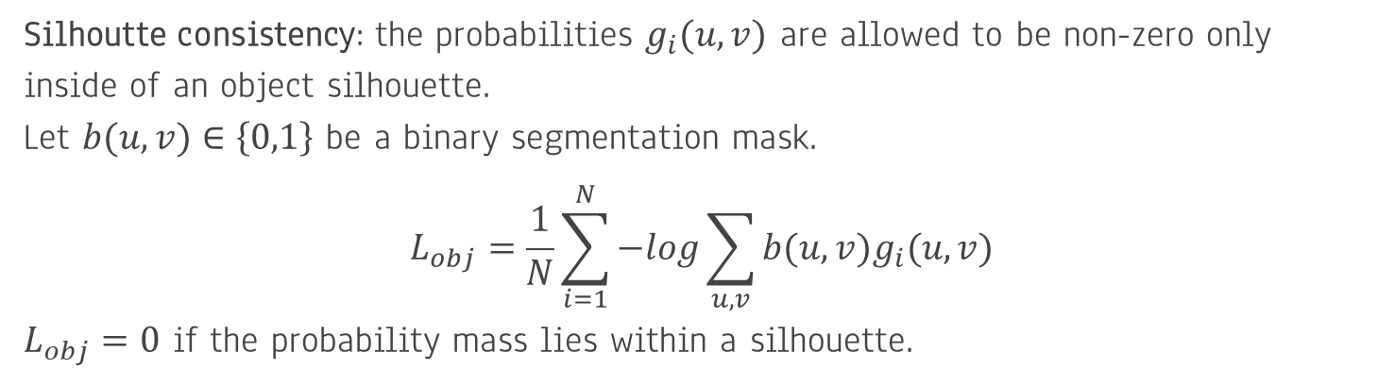
KeypointNet
REGULARIZATION
Silhoutte consistency: the probabilities $g_{i}(u,v)$ are allowed to be non-zero only
inside of an object silhouette.
Let $b(u,v)∈\left\{0,1\right\}$ be a binary segmentation mask.
$$L_{obj}=\frac{1}{N}\sum_{i=1}^{N}{−log\sum_{u,v}{b(u,v)g_{i}(u,v)}}$$
$L_{obj}=0$ if the probability mass lies within a silhouette.
26

Slide 29
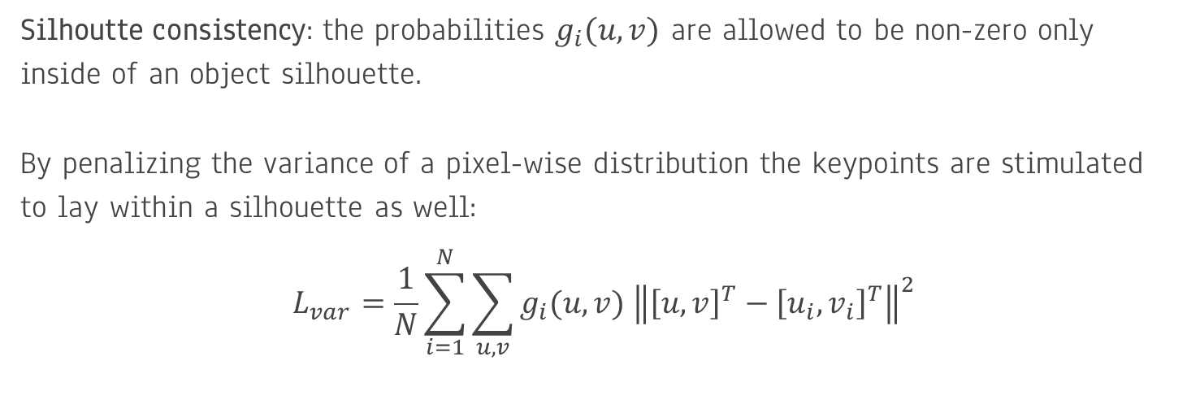
KeypointNet
REGULARIZATION
Silhoutte consistency: the probabilities $g_{i}(u,v)$ are allowed to be non-zero only
inside of an object silhouette.
By penalizing the variance of a pixel-wise distribution the keypoints are stimulated
to lay within a silhouette as well:
$$L_{var}=\frac{1}{N}\sum_{i=1}^{N}{\sum_{u,v}{g_{i}(u,v) {\left\|{\left[u,v\right]}^{T}−{\left[u_{i},v_{i}\right]}^{T}\right\|}^{2}}}$$
27

Slide 30
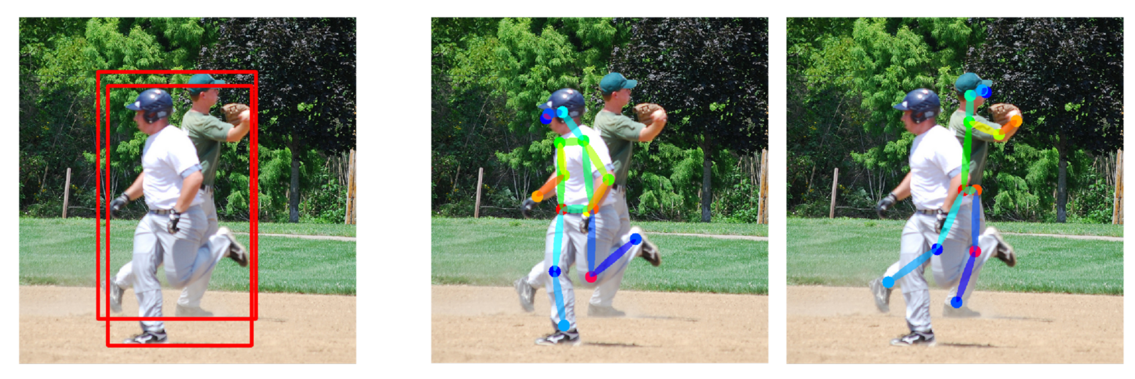
APPLICATIONS IN CV
POSE2SEG: OVERVIEW
Previously: object detection instance segmentation;
Problem: heavily occluded people are unrecognizable;
Better solution: pose estimation instance segmentation;
28

Slide 31
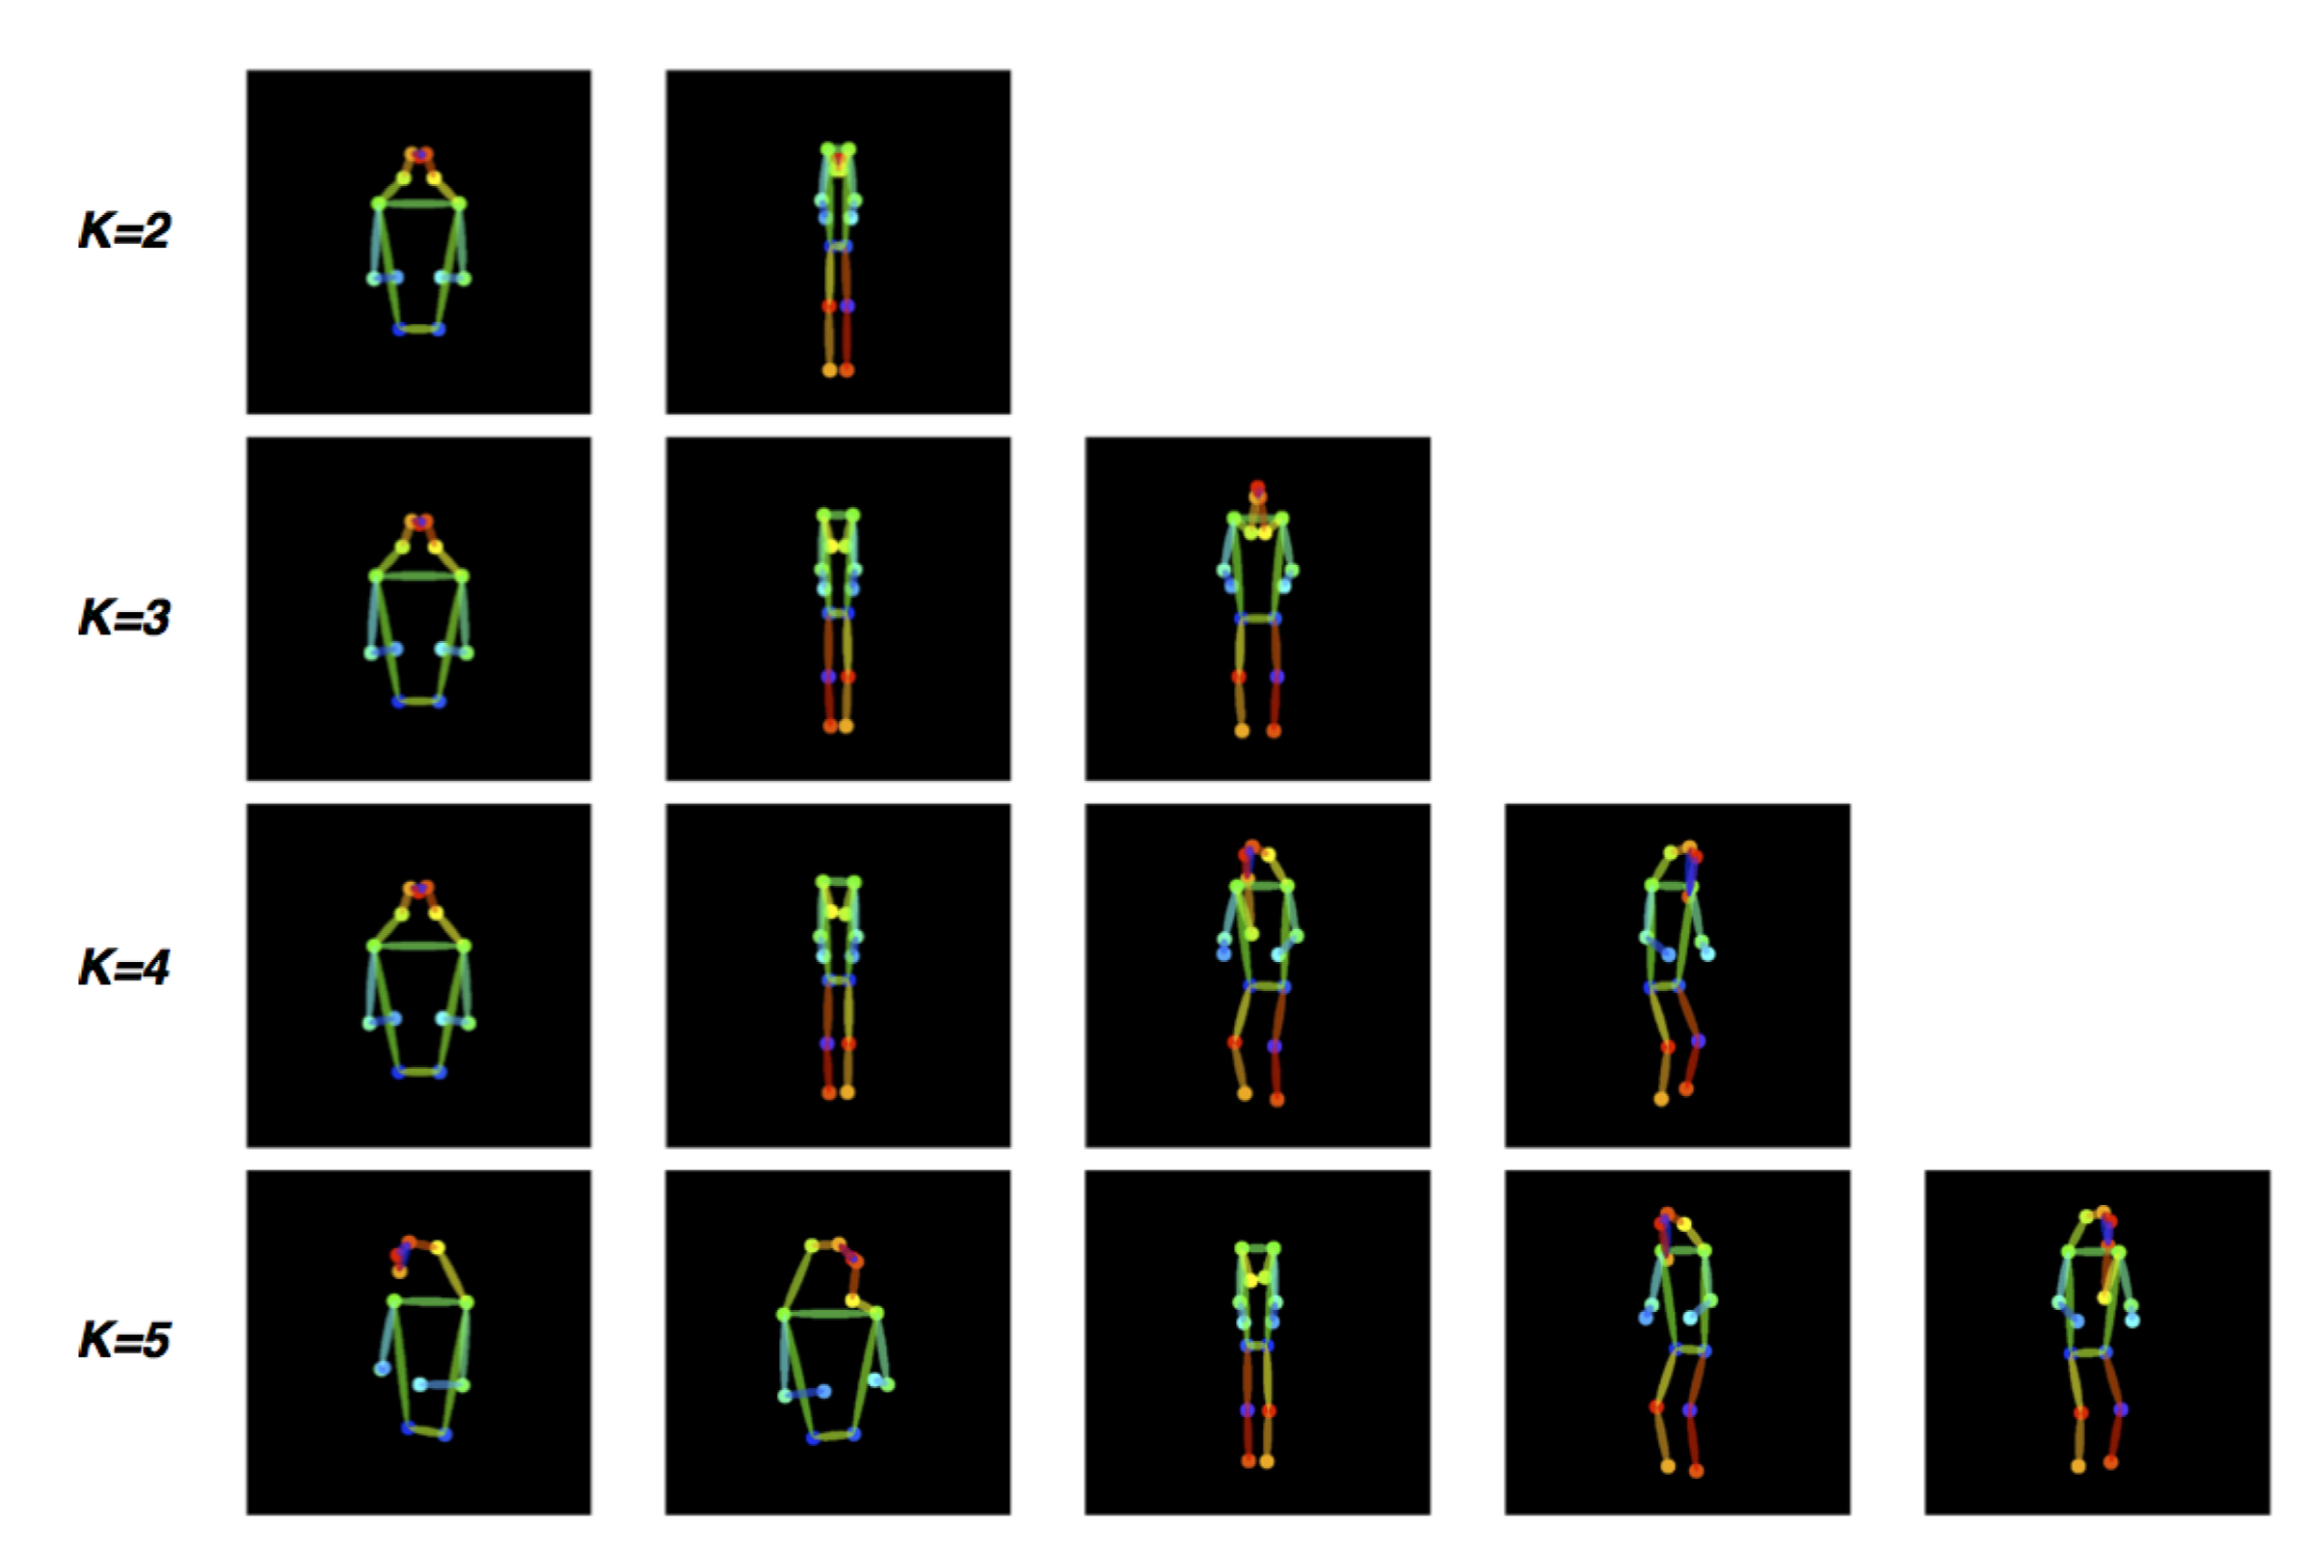
APPLICATIONS IN CV
POSE2SEG: OVERVIEW
Clusterization of main human poses based on K-means;
Choose the best affine transformation H among pose templates and a given pose;
Apply transformation H to an input image;
29

Slide 32
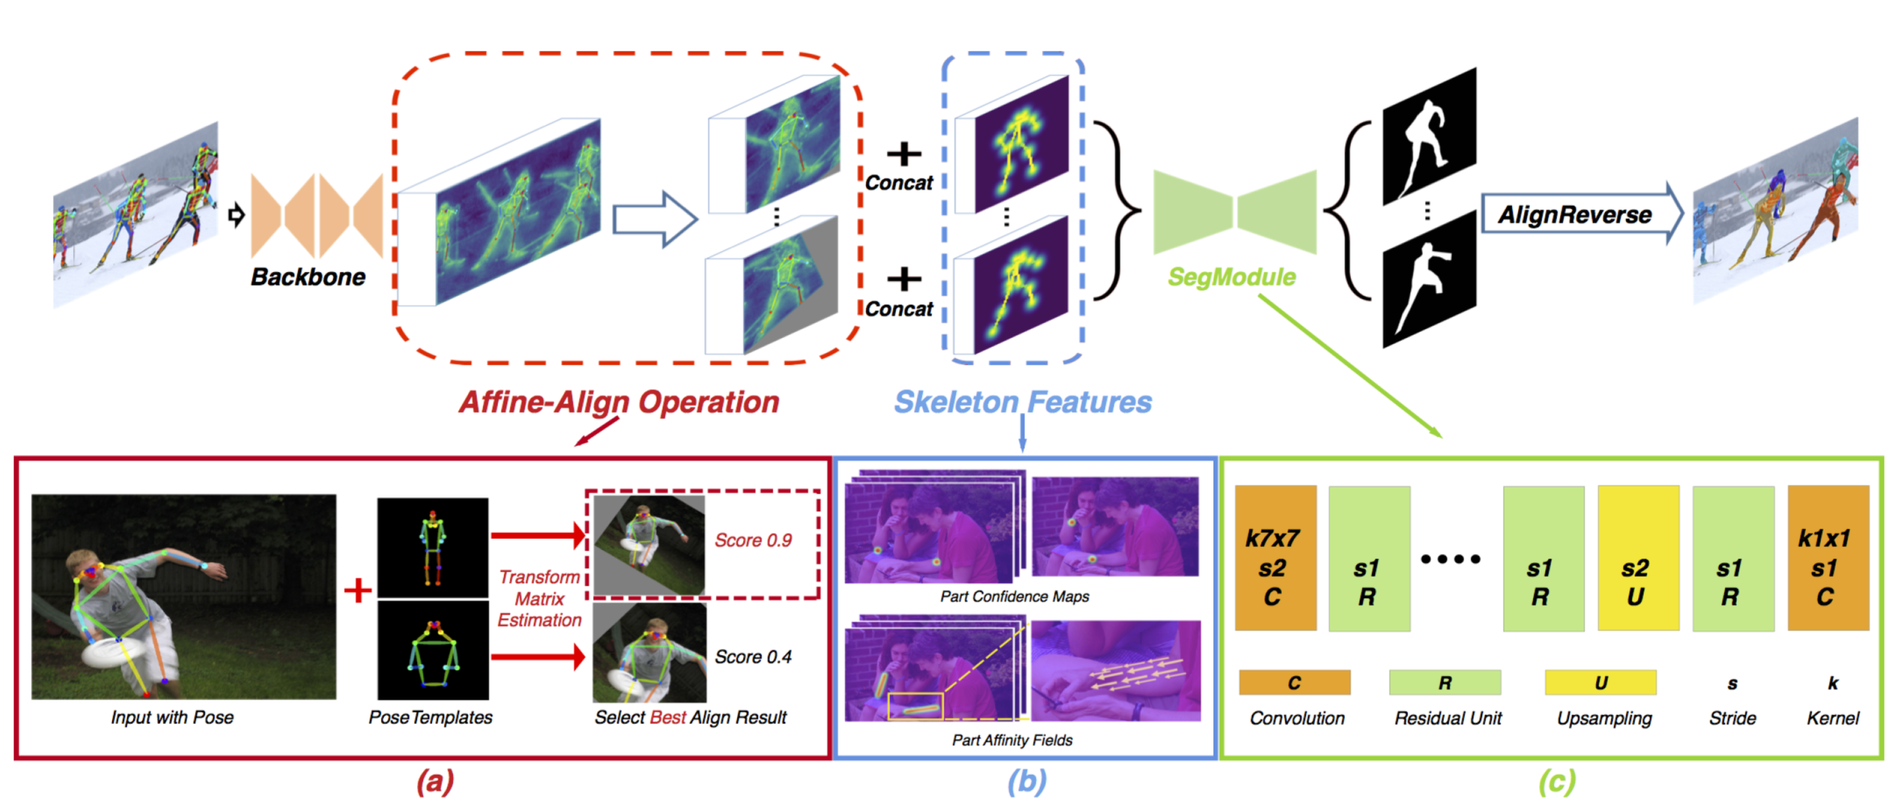
APPLICATIONS IN CV
POSE2SEG: OVERVIEW
30

Slide 33
05 VISUALIZATION

Slide 34
QUESTIONS
Describe a perspective projection operation, rigid transformations and a mult-view consistency loss.
Formulate the Orthogonal Procrustes Problem and describe how it is used in KeypointNet.
Write out a silhouette consistency loss. How does it help in training?

Slide 35
REFERENCES
Suwajanakorn et. al (2018)
Discovery of Latent 3D Keypoints via End-to-end Geometric Reasoning
Zhang et. al (2018)
Pose2Seg: Detection Free Human Instance Segmentation
Chang et. al (2015)
ShapeNet: An Information-Rich 3D Model Repository
Hejrati et al (2012)
Analyzing 3D Objects in Cluttered Images

